Slide 1
Internet Programming Practicum
Lecturers : Kurniawan, S.Kom., M.M.
Module 4
Credits : 4
Information System Study Program

Slide 2
HTML Tables
Lecturers : Kurniawan, S.Kom., M.M.
Tables are defined with the <table> tag.
A table is divided into rows (with the <tr> tag), and each row is divided into data cells (with the <td> tag). td stands for "table data," and holds the content of a data cell. A <td> tag can contain text, links, images, lists, forms, other tables, etc.

Slide 3
Example:
Lecturers : Kurniawan, S.Kom., M.M.
<table border="1">
<tr>
<th>Header 1</th>
<th>Header 2</th>
</tr>
<tr>
<td>row 1, cell 1</td>
<td>row 1, cell 2</td>
</tr>
<tr>
<td>row 2, cell 1</td>
<td>row 2, cell 2</td>
</tr>
</table>

Slide 4
List of Table Tag
Lecturers : Kurniawan, S.Kom., M.M.
List of <tr> <td> <th> Tag
Attribute Tag Table

Slide 5
Exercise 3 (tabel.html)
Lecturers : Kurniawan, S.Kom., M.M.

Slide 6
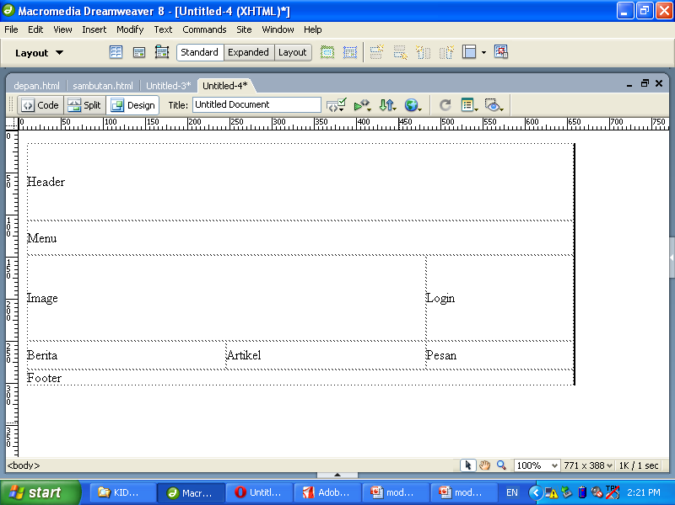

Slide 7
